Slide 1
HOUSING PRICE PREDICTION PROJECT
BY:- Ayush Pathak

Slide 2
Problem Statement:
A US-based housing company named Surprise Housing has decided to enter the Australian market.
The company uses data analytics to purchase houses at a price below their actual values and flip them at a higher price. For the same purpose, the company has collected a data set from the sale of houses in Australia.
We are required to build a model using Machine Learning in order to predict the actual value of the prospective properties and decide whether to invest in them or not.

Slide 3
Review of Literature
Houses are one of the necessary needs of each and every person around the globe and therefore housing and real estate market is one of the markets which is one of the major contributors in the world’s economy.
A US-based housing company named Surprise Housing has decided to enter the Australian market. The company uses data analytics to purchase houses at a price below their actual values and flip them at a higher price.
We are required to build a model using Machine Learning in order to predict the actual value of the prospective properties and decide whether to invest in them or not.

Slide 4
Conceptual Background of the domain
A US-based housing company named Surprise Housing has decided to enter the Australian market.
The company uses data analytics to purchase houses at a price below their actual values and flip them at a higher price. For the same purpose, the company has collected a data set from the sale of houses in Australia.
We are required to build a model using Machine Learning in order to predict the actual value of the prospective properties and decide whether to invest in them or not.

Slide 5
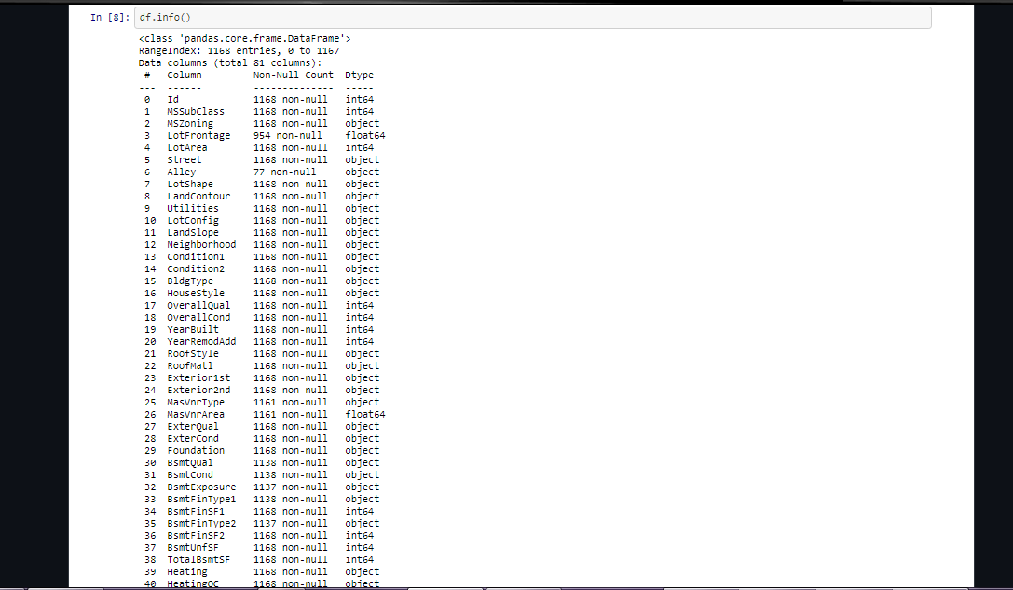
Dataset
A lot null values
Target variable is Sale Price
Maximum SalePrice of a house observed is 755000 and minimum is 34900.

Slide 6
Data Cleaning Steps:
Checking Missing values
Dropping columns & imputation accordingly
Applying z score on outliers
Handling skewness
PCA

Slide 7
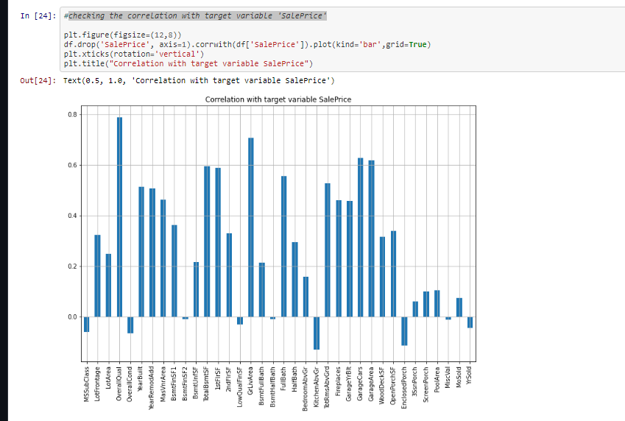
DATA INPUTS- LOGIC- OUTPUT RELATIONSHIPS

Slide 8
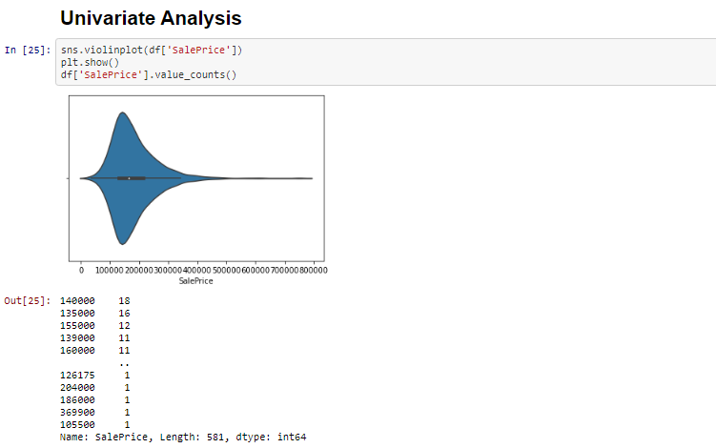
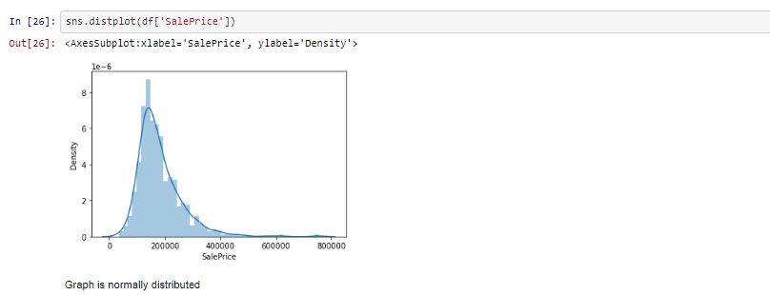
PLOT of the Target Variable

Slide 9
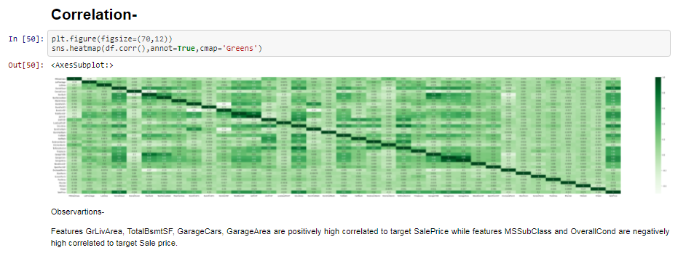
Correlation
Observartions-
Features GrLivArea, TotalBsmtSF, GarageCars, GarageArea are positively high correlated to target SalePrice while features MSSubClass and OverallCond are negatively high correlated to target Sale price

Slide 10
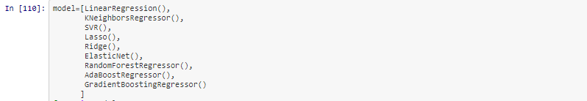
Modelling
Model Name-
LR=LinearRegression(),
KNN=KNeighborsRegressor(),
SV=SVR(),
LS=Lasso(),
RI=Ridge(),
EN=ElasticNet(),
RFR=RandomForestRegressor(),
ADA= AdaBoostRegressor(),
GBR=GradientBoostingRegressor()

Slide 11
Evaluation Metrics Used:
Accuracy score
Cross_val_score
R2_score
MAE
MSE
RMSE

Slide 12
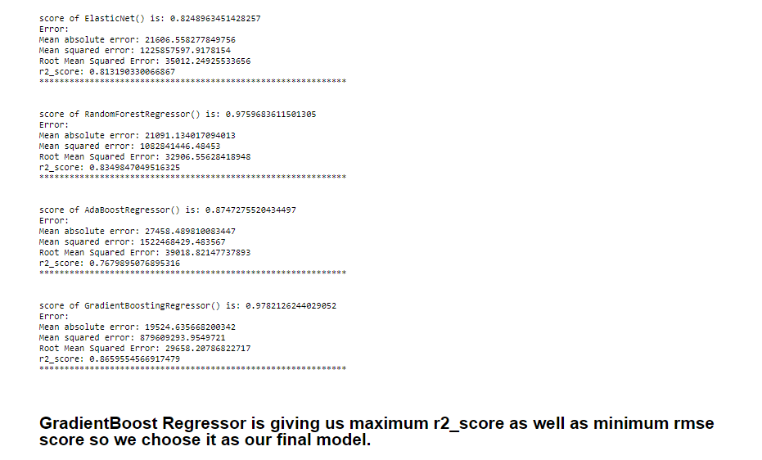
Model Score
Hyper parameter tunning for GradientBoost Regressor, to enhance chosen model performance.

Slide 13
CONCLUSION
In this project we have tried to show how the house prices vary and what are the factors related to the changing of house prices. The best(minimum) RMSE score was achieved using the best parameters of Gradient Regressor through GridSearchCV though Gradient Boost Regressor model performed well too.
This project has demonstrated the importance of sampling effectively, modelling and predicting data.
Through different powerful tools of visualization we were able to analyse and interpret different hidden insights about the data.
Through data cleaning we were able to remove unnecessary columns and outliers from our dataset due to which our model would have suffered from overfitting or underfitting.
There were lot of missing values present in different columns which we imputed on the basis of our understanding.

Slide 14
LIMITATIONS
However, the output of these algorithms needs to be in the same format as the others. Once that condition is satisfied, the modules are easy to add as done in the code.
This provides a great degree of modularity and versatility to the project.

Slide 15
THANK YOU

